Slide 1
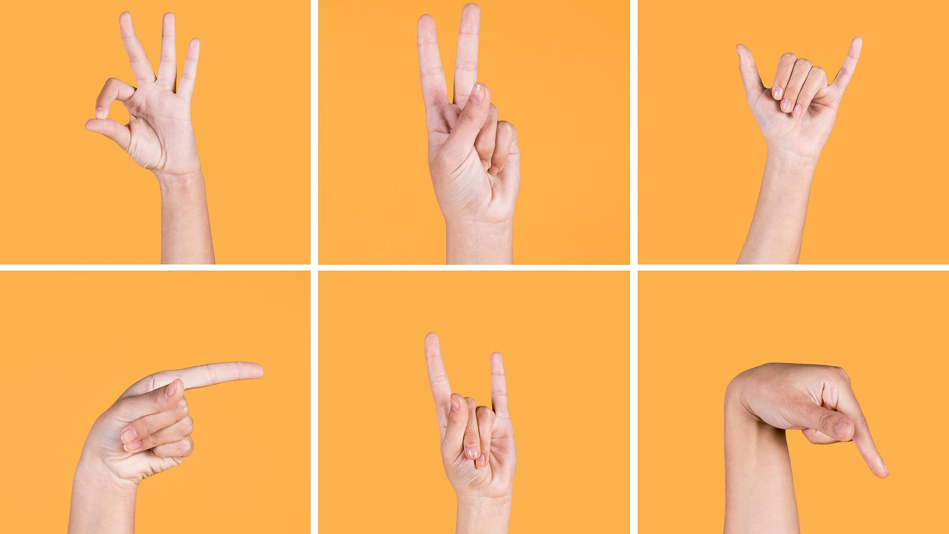
INDIAN
SIGN LANGUAGE TRANSLATOR

Slide 2
CONTENTS OF THIS TEMPLATE
Problem Statement
Available Solutions
Proposed Solutions
How our solution is different from them
Target Audience
Technology
Financial Feasibility
Sample survey of the proposed solution

Slide 3

Problem Statement
According to WHO (2018) data, the prevalence of hearing impairment (HI) in India is around 6.3% (63 million people suffering from significant auditory loss). The estimated prevalence of adult-onset deafness in India is 7.6% and childhood-onset deafness is 2%. Resulting in communication problem with everyone, as not everyone knows the Indian sign language.
They may hear your voice, but still may have difficulty understanding some words. Most hearing-impaired people have greater difficulty understanding speech when there is background noise. The best way to communicate with them is through the sign language.

Slide 4
Available Solutions
01
02
03
04
Master Sign Language
Indian Sign Language Translator
Sign language ASL
Spread Signs
10K+ Downloads 3.6/5 Rating
1K+ Downloads 3/5 Rating
100K+ Downloads 3.8/5 Rating
200K+ Downloads 4/5 Rating

Slide 5

PROPOSED SOLUTION
Our App focuses on ISL (Indian Sign Language) whereas most apps that you see around are only offering English to Sign Language translation.
Our App will have regional Indian languages like Hindi, Marathi, Bengali, etc which are spoken widely around the country.
Other apps are only for learning Sign Language but our app primarily focusses on easing communication with the disabled ones.

Slide 6

App | Voice command | GIF Visualization | Multi platform support | Multi language support | ISl support
Our app | yes | yes | yes | yes | yes
Master sign lang | no | no | no | no | no
Indian sign lang translator | no | no | no | no | yes
Sign lang asl | no | yes | no | no | no
Spreads signs | no | no | no | no | no

Slide 7
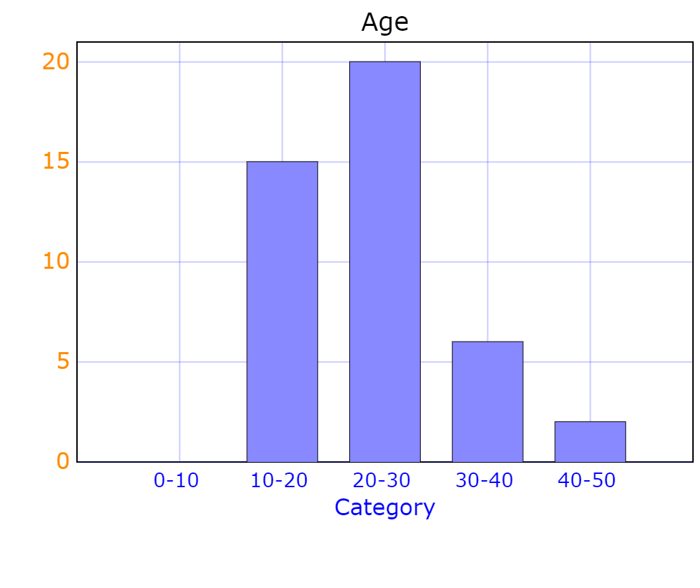
TARGET AUDIENCE
63 million people (6.3%) suffer from significant auditory loss/mute.
Four in every 1000 children suffer from severe to profound hearing loss.
With over 100,000 babies that are born with hearing deficiency every year.
Ref : Indian Journal Of Otology

Slide 8
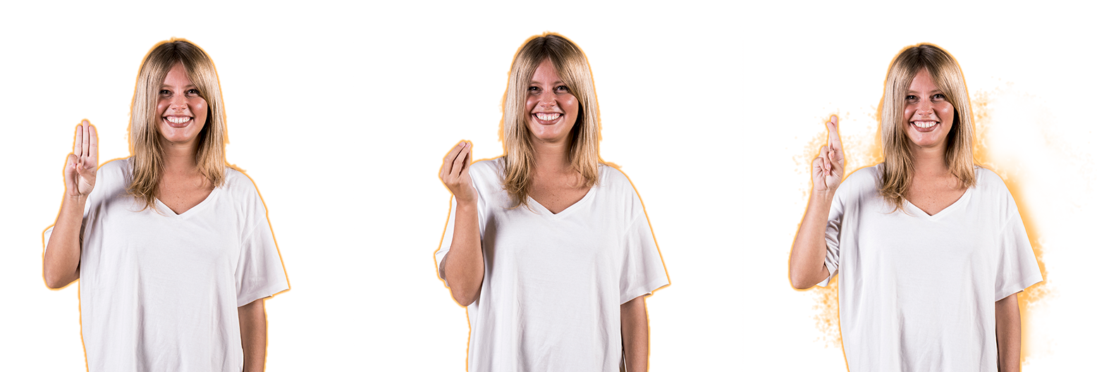
TECHONLOGY USED
Python
NLP
EasyGui
01
02
03
Python is an interpreted high-level general-purpose programming language.
Module for very simple, very easy GUI programming in Python.
Natural Language Processing, is a branch of AI that deals with the interaction between computers and humans

Slide 9
FINANCIAL FEASIBILITY
SUBSCRIPTION
Mixed Monetization
Advertising
Subscription is when developers charge users a recurring fee to use the app.
Mixed monetization strategy is to ask users to pay to remove ads. This is good as an alt to a paid app.
. Advertising is commonly used by apps that offer content to users for free.
In-app advertising
Affiliate links
Sponsorship for app
App publishers earn money based on the interactions on the advertisements displayed within the application.
You negotiate with a few interested parties and place their reference links in your application.
Link up with a company that stands to benefit most from the target market you'll be capturing.

Slide 10
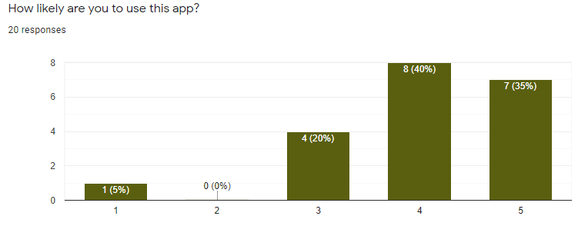
How likely are you to use this app?

Slide 11
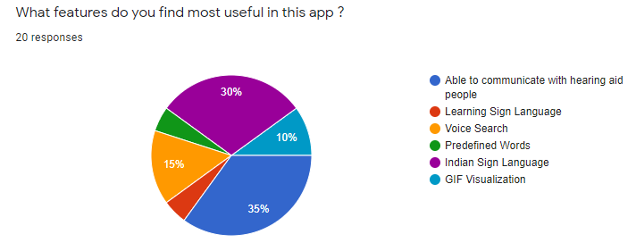
What Features do you find most useful in this app?

Slide 12
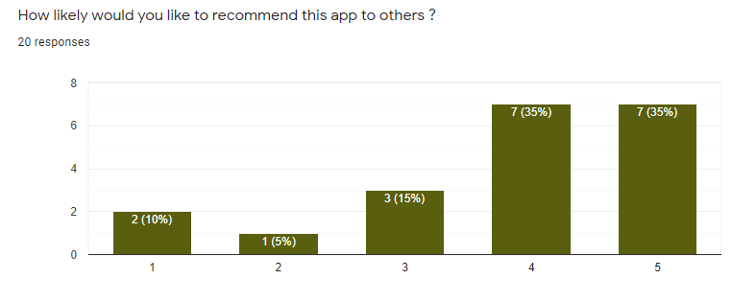
How likely would you like to recommend it to others?

Slide 13
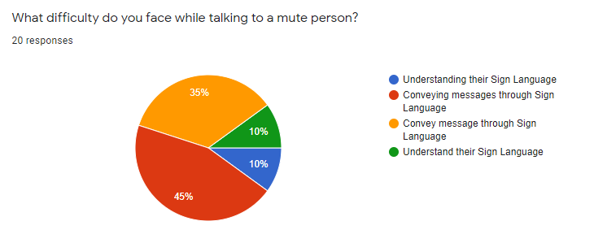
What difficulties do you face while talking to deaf/disabled person ?

Slide 14
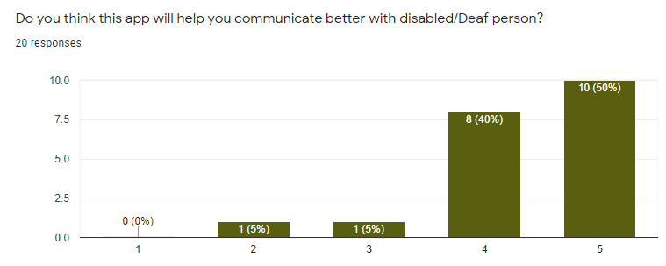
Do you think this application can help you communicate better with a disabled/deaf person??

Slide 15
REFRENCES
Indian Journal Of Otology
Disabled Population in India
India’s disability estimates: Limitations and way forward
A Survey on Communication Gap Communication Gap between between
Hearing and Speech Impaired Speech and Normal Persons

Slide 16
THANKS !!
Does anyone have any questions?
Presented By
R
USHIKESH BODKE
YUVRAJ GUPT
A
R
AHUL PAREEK
A
SURAJ DHAR

